Slide 1

ADAPTIVE CONTINUOUS AUTHENTICATION USING BEHAVIORAL BIOMETRICS
Submitted By: Varada Anup
Roll no: MUT24MCA2058
Project Guide: Asst. Prof. Jiss Kuruvilla
1

Slide 2
INTRODUCTION
Traditional authentication systems verify users only at the time of login and assume the same user remains active throughout the session, this assumption creates security risks such as session hijacking and unauthorised access after successful login.
Continuous authentication enhances security by continuously monitoring user behaviour during active sessions.
Behavioural biometrics focus on how users interact with a system rather than what credentials they provide.
Keystroke dynamics and mouse movement patterns are effective, non-intrusive behavioural indicators.
This project aims to design an adaptive continuous authentication system using behavioural biometrics.
2

Slide 3
PROBLEM STATEMENT
Traditional authentication (passwords, OTPs, MFA) is static, verified only at login.
Password reuse and phishing attacks lead to high account compromise rates.
Existing continuous authentication systems often :
Are mobile-focused (not web-based)
Lack adaptability to user behavior changes
Don’t integrate multi-modal behavioral patterns with context
Problem Statement: Need a web-based continuous authentication system that dynamically verifies users based on behavioral biometrics, adapts to behavioral drift, and minimizes friction for legitimate users.
3

Slide 4
OBJECTIVES
To design and implement a web-based adaptive continuous authentication system that monitors real-time keystroke and mouse behaviour, detects anomalous user activity through behavioural drift analysis
Triggers secure alert notifications and realtime verification for suspicious sessions.
4

Slide 5
LITERATURE REVIEW
Title | Author(s) | Year | Source | Relevance
Behavioral Biometrics‑Powered Continuous Authentication for Zero‑Trust Remote Work Environments | Suleiman S. Abba et al. | 2025 | Asian Journal of Research in Computer Science | Real‑time continuous authentication with ensemble ML + context
Continuous Authentication in the Digital Age: An Analysis of Reinforcement Learning and Behavioral Biometrics | Priya Bansal & Abdelkader Ouda | 2024 | Computers (MDPI) | RL‑based keystroke continuous authentication model
Machine learning‑based novel continuous authentication system using soft keyboard typing behavior and motion sensor data | Ensar Arif Sağbaş & Serkan Ballı | 2024 | Neural Computing and Applications | Multi‑modal behavioral authentication using typing + sensors
5

Slide 6
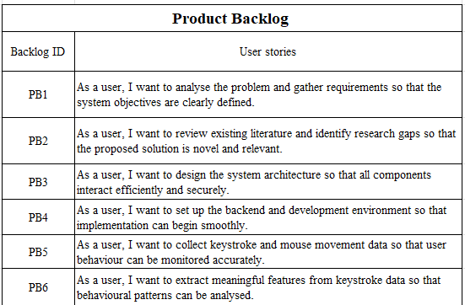
PRODUCT BACKLOG
6

Slide 7
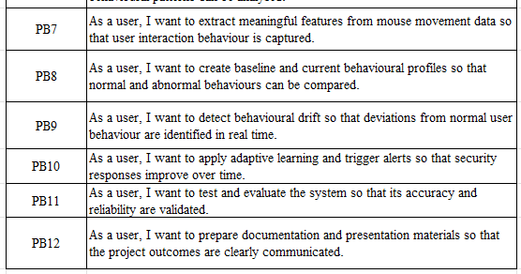
7

Slide 8
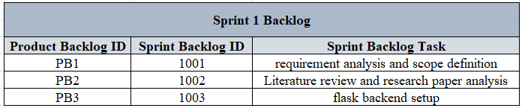
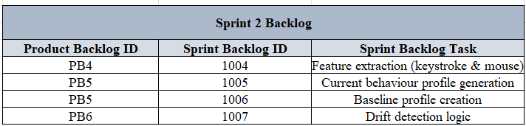
SPRINT BACKLOG
8

Slide 9
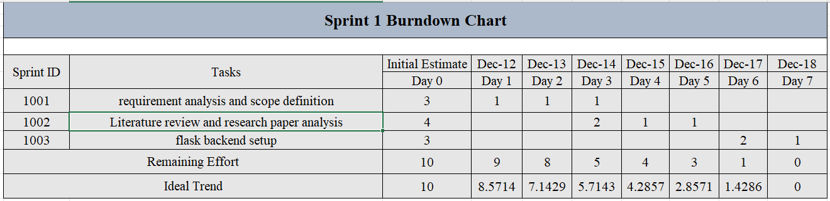
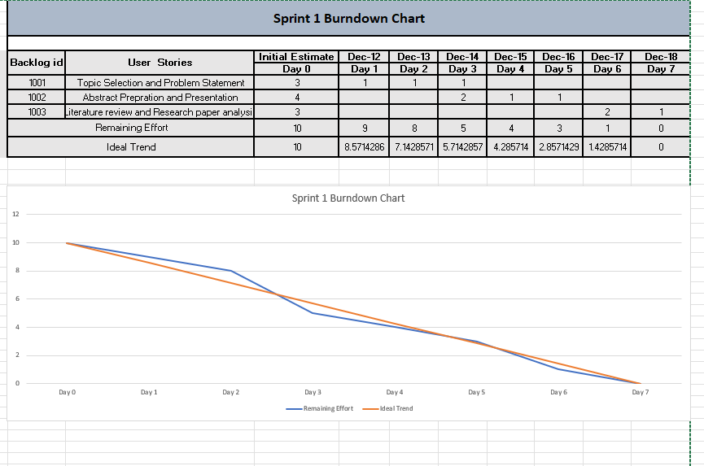
SPRINT 1 BURNDOWN CHART
9

Slide 10
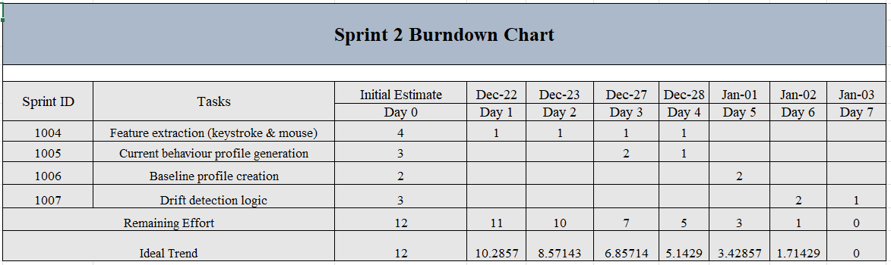
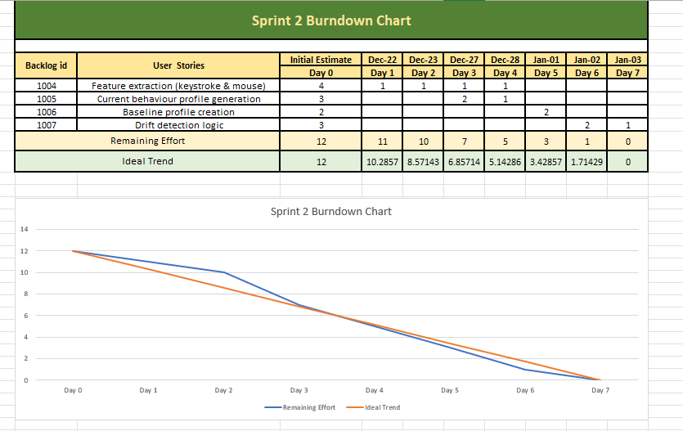
SPRINT 2 BURNDOWN CHART
10

Slide 11
PROJECT UPDATE
What has been completed:
Real-time behavioural data collection using Flask backend
Robust behaviour log management with error handling
Extraction of keystroke and mouse-based behavioural features
Creation of baseline and current behavioural profiles
Verified behavioural drift detection using real user data
Email alert mechanism with cooldown to prevent spam
What is in progress:
Stabilising execution flow between modules
Controlled adaptive baseline updates
End-to-end automation testing
11

Slide 12
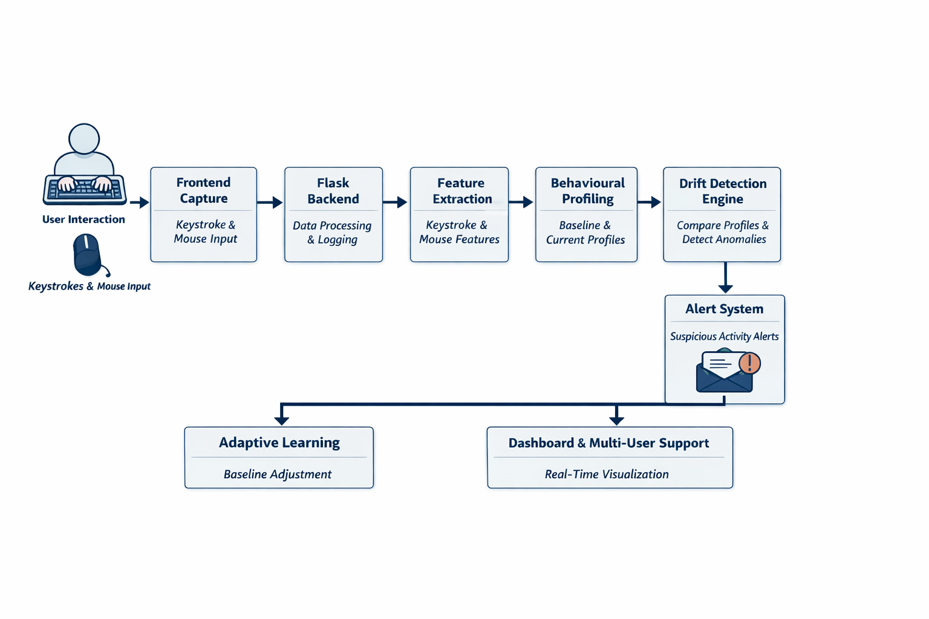
Project Workflow
12

Slide 13
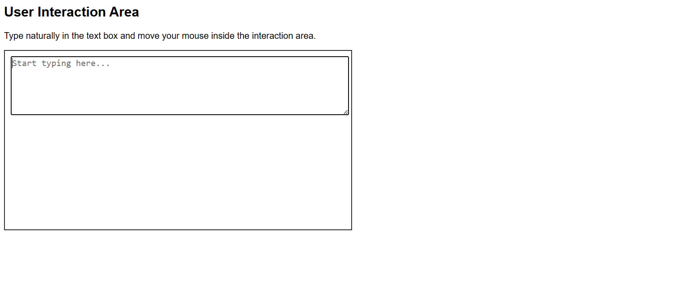
User Interaction Area
13

Slide 14
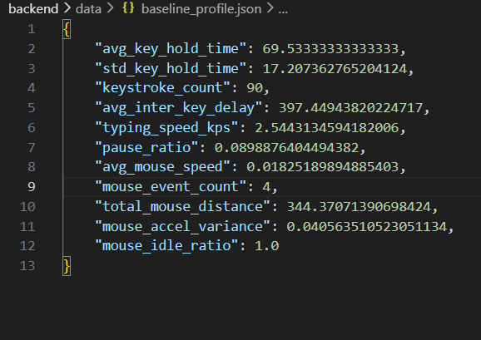
Extracted Features
14

Slide 15
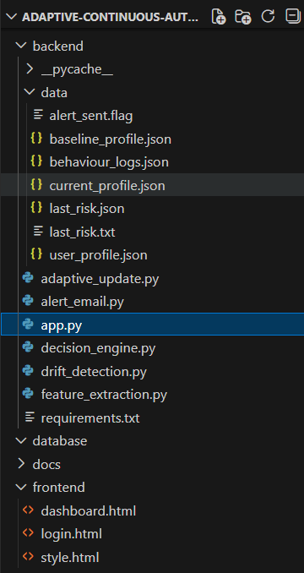
Current Implementation
Modular separation of frontend and backend
Frontend captures keystroke and mouse interactions
Flask backend receives and processes interaction data
Behavioural logs stored in structured JSON format
Feature extraction performed on collected data
Baseline and current behaviour profiles maintained
Behavioural drift detected by profile comparison
15

Slide 16
REFERENCES
Bansal, P., & Ouda, A. (2024). Continuous Authentication in the Digital Age: An Analysis of Reinforcement Learning and Behavioral Biometrics. Computers, 13(4), 103. https://doi.org/10.3390/computers13040103
Suleiman S. Abba, Onyinye Agatha Obioha-Val, Valerie Ojinika Ejiofor, Oluwadayo Mafolasere Olaniyi & Nanyeneke Ravana Mayeke. (2025). Behavioral Biometrics-Powered Continuous Authentication for Zero-trust Remote Work Environments: A Multi-factor Identity Verification Framework. Asian Journal of Research in Computer Science, 18(12), 20–41. https://doi.org/10.9734/ajrcos/2025/v18i12788
Sağbaş, E. A., & Ballı, S. (2024). Machine learning-based novel continuous authentication system using soft keyboard typing behavior and motion sensor data. Neural Computing and Applications, 36
16

Slide 17
THANK YOU
17

